Slide 1
A Simple ECG Workflow
Using Standards and Open Source Tools
Steve Smiley – Smiley Color & Associates, LLC
Charles Spontelli – Graphic Arts Consulting, LLC / BGSU
William Birkett – Doppelgänger, LLC
Presented February 29, 2024
Notes:
JOE
Introductions
Joe introduces Steve, Chuck and Bill.
Joe can also mention the FTA ECG project, what we learned, and the new PDF Color Mapping tool
that led to this presentation. We will cover that in more detail.

Slide 2
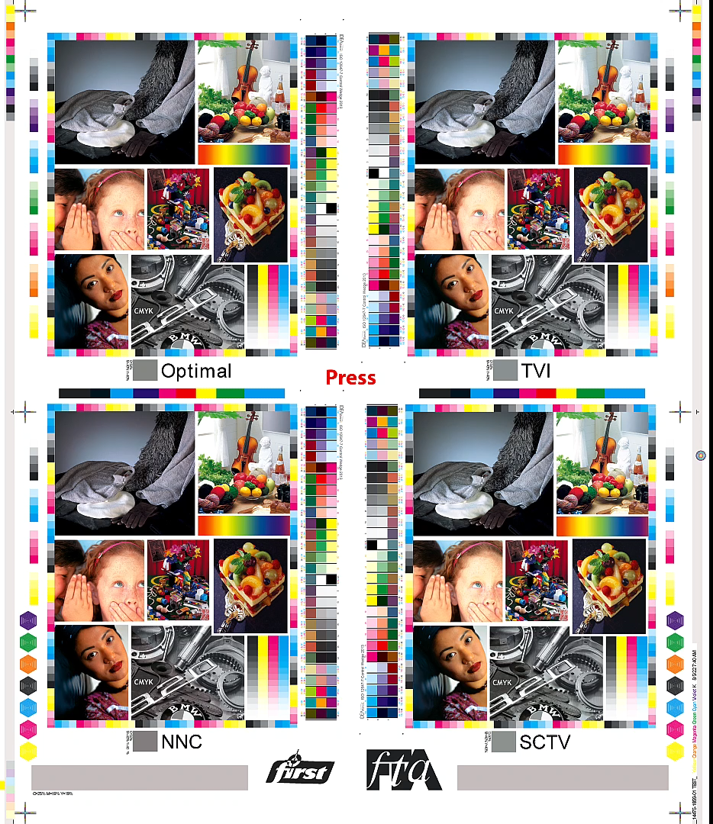
Fall Conference 2022
Tested PressCal toolset developed by
William (Bill) Birkett and Charles (Chuck) Spontelli
  Tested
    TVI
    SCTV
    G7
    Optimal Method
You Asked? What about multicolor printing?
Notes:
STEVE

Slide 3

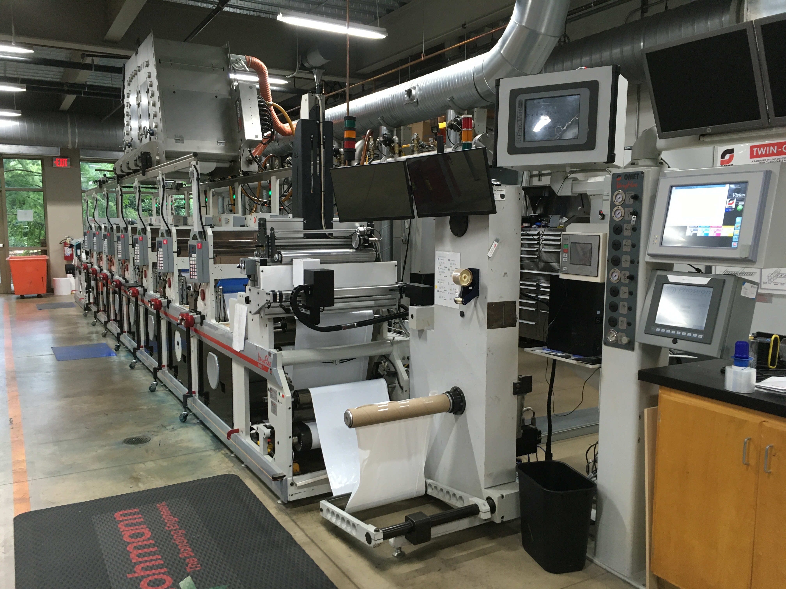
SONOCO INSTITUTE – Clemson Univ.
Notes:
STEVE
Mention where we did the trial printing for the FTA ECG project.

Slide 4

Why Extended Color Gamut?
Advantages of ECG
  Streamlines makeready and production
  Larger gamut allows replacing most spots
  Allows running multiple jobs with multiple brand colors across web - allows smaller minimum runs for clients
  Removes or reduces spot color inventory
  Environmental Benefits (Green) Brand Goals
Notes:
STEVE
Steve’s introduction. Will expand on this and or other benefits.

Slide 5
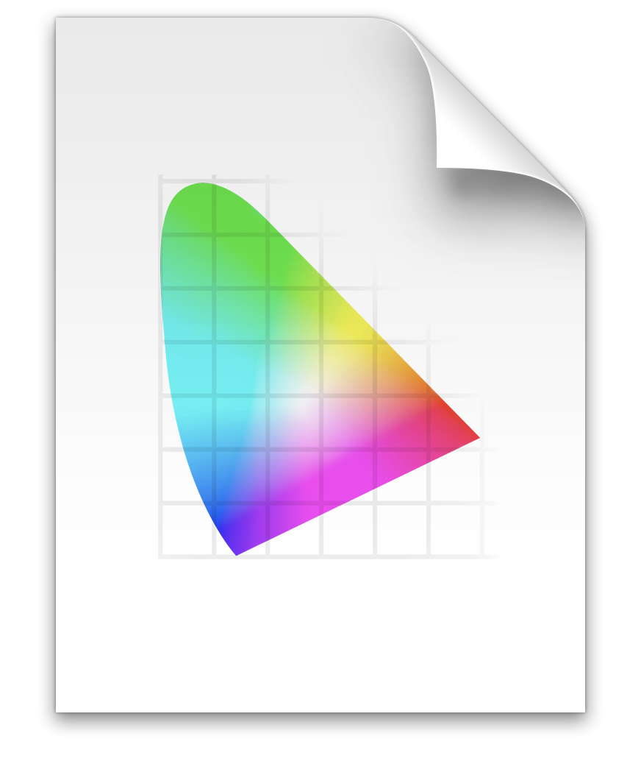
FTA 2023 ECG Project
7-Color FTA ECG ICC profile
  Idealliance 7-Color Chart (4340 patches)
  Ink colors CMYKOGV (Published FTA FIRST)
  CMYK aligned with CRPC6 (GRACoL2013)
  OGV aligned with Linear SCTV (Spot Color tone value)
FTA 7C ECG.icc
Notes:
STEVE
This is the CENTERPIECE of our ECG Workflow.
It is the ECG color reference we are trying to match.
Steve discusses the rationale and merits of the FTA 7-Color ICC profile.
Good profile to begin ECG work b/c of CMYK alignment with CRPC6 and and OGV alignment to SCTV
A major success of the 2023 FTA ECG project.
Available for download from the FTA.

Slide 6
2023 FTA ECG Project
Poster Test File
  Illustrator document
  24 spot colors and RGB equivalents (Kai Lankinen)
  RGB Images
  Saved as PDF/X-4
  RGB converted to CMYK
Notes:
STEVE
Explain the poster and its complexities

Slide 7
2023 FTA ECG Project
“The Good, the Bad,
and the Ugly”
Notes:
CHUCK
The Good, the Bad and the Ugly
We accomplished most of our objectives (good).
The reference profile aligns with GRACoL2013 and linear SCTV (good).
The reference profile is very ”clean” and could be used for flexo UV processes (good).
The re-calibration two months later worked (good).
The spot color mixes were “mixed”. Some were right on, and others way off.
The inks were not formulated correctly for the anilox volumes (bad).
Variability of the printing process was greater than expected (bad).
There was no straightforward way to substitute spot color mixes using the Esko workflow (bad).
We spent many hours finding a workaround to make the final test plates (ugly!!).
No shame for things that failed or fell short, providing we learned something.

Slide 8
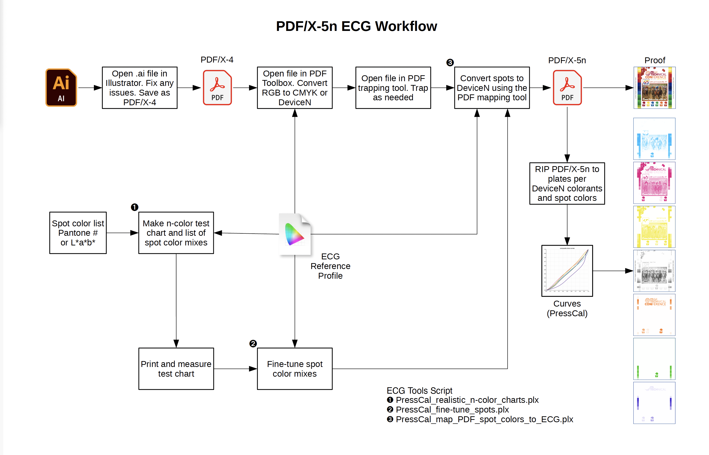
ECG Workflow
NEW Tool
3
1
2
Notes:
CHUCK
This was our ECG workflow that used inexpensive and FREE software.
It consists of three main software tools. I will introduce and BILL will Demonstrate.
- N-Color Chart Tool
- Fine-Tune Spot Color Mixes Tool
- NEW Tool - PDF Color Mapping
NEW Tool
At the time of the FTA ECG project, we did not have a tool to map our spot colors to our ECG spot color mixes.
This led to our continued work to solve the problem of automatically replacing spot color with ECG mixes in a PDF..

Slide 9
ECG Workflow
3
1
Spot Color ECG Mixes
2
Notes:
CHUCK
The 7-Color FTA ECG ICC profile is the CORE of this workflow.
It is the reference for printing the CMYK to CRPC6 and OGV to SCTV Linear.
It provides the initial ECG mixes to replace spot colors.
FIRST, we must create accurate ECG Spot Color Mixes
The n-color chart software generates hundreds of ‘realistic’ ECG samples from the FTA 7-color ECG ICC profile.
It includes your list of spot (L* a* b*) colors converted to ECG mixes.
The ECG mix formula can be modified to favor:
- CMY mixes
- Non-CMY mixes
- Profile B2A (L*a*b* to Device) mixes
BILL WILL EXPLAIN THIS IN DETAIL.
The initial spot color ECG mixes can be fine-tuned to an even closer match to the spot color specification
with the Fine-Tune Spot Color Mix Tool.

Slide 10
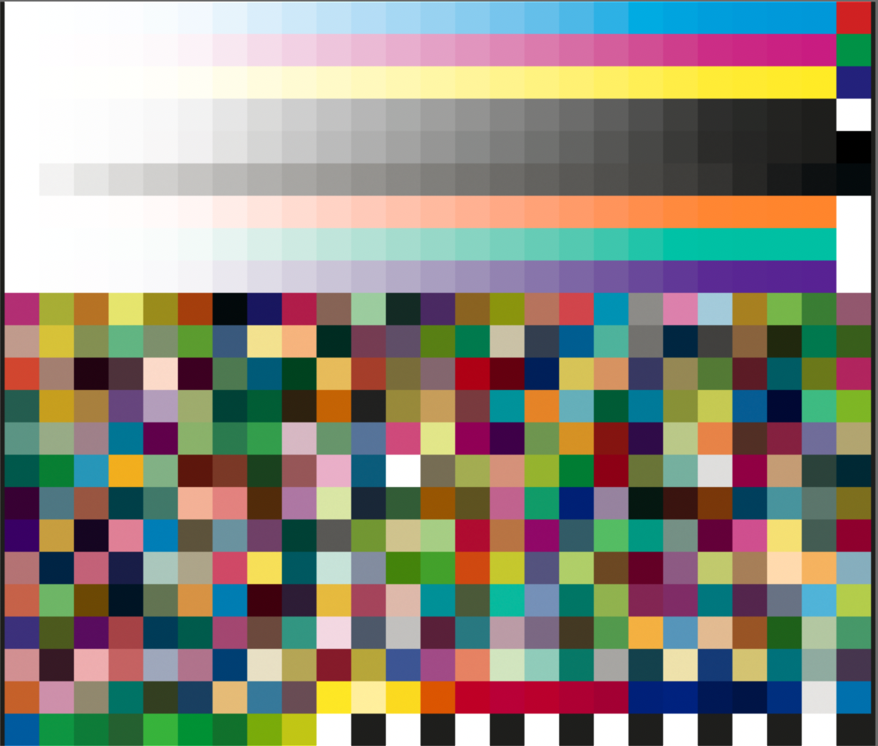
N-Color Calibration Chart
1
‘Realistic’ Colors
from the 7/C Profile
Includes Initial ECG
Spot Color Mixes
ECG Mix File
for Fine-Tuning

Slide 11
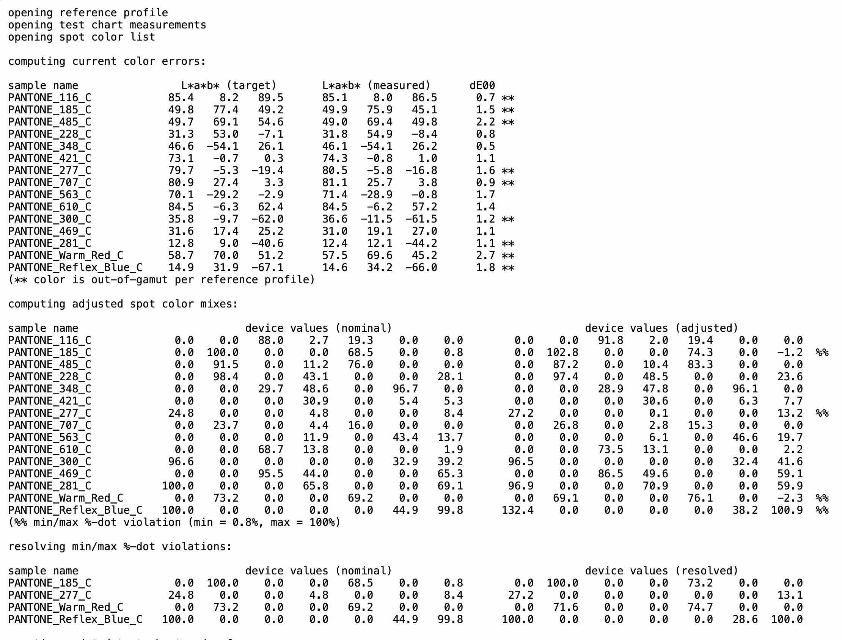
Fine-Tuning
Spot Color Mixes
2
Color Errors
References:
  FTA 7/C
  ECG ICC Profile
  Test Chart Measurements
  Spot Color List (L*a*b*)
Fine-Tuned
Min – Max % Correction
Notes:
CHUCK
ECG spot color mixes can be further fine-tined to even a closer match with the Fine-Tuning tool.
The software tool references:
- FTA 7/color ECG profile
- Test chart measurements
- List of spot colors (L* a* b*).

Slide 12
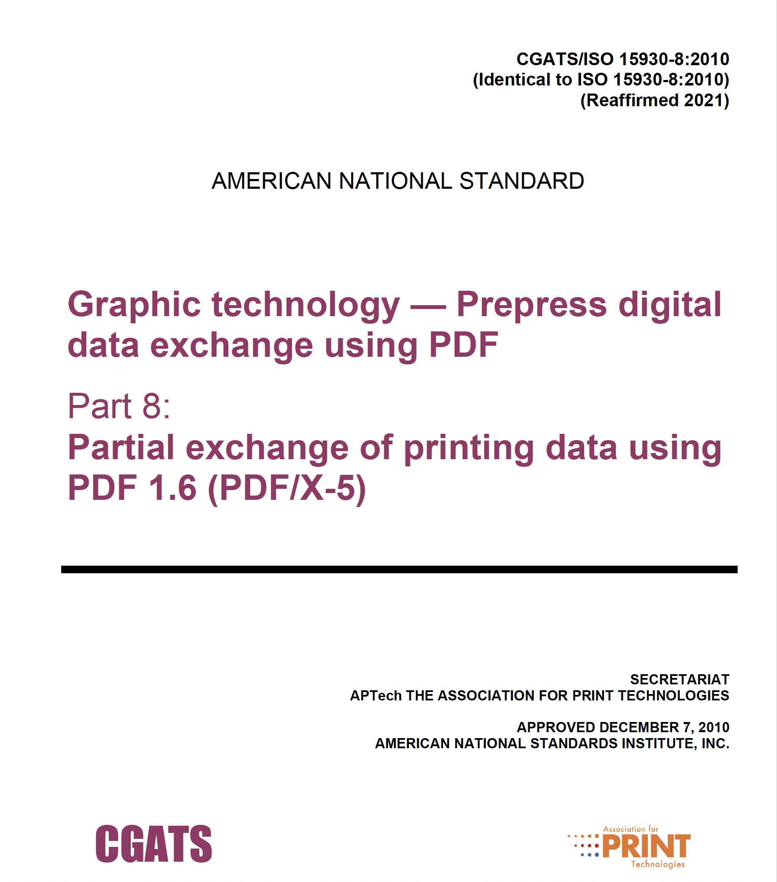
PDF Color Mapping Tool
3
Employs:
  PDF/X-4 with 24 spot colors
  FTA 7/C ECG ICC Profile
  List of Fine-tuned ECG
  spot color mixes
Creates PDF/X-5n with
n-Color space
ISO
Notes:
CHUCK
This is the Key Tool we were missing in our FTA ECG project. This led us to craft a solution –
The PDF Color Mapping Tool.
It Creates an ISO Standard PDF/X-5n with n-color space.
This standard was approved in 2010 and reaffirmed in 2021.
The PDF color mapping tool replaces the 24 spot colors in the PDF with the fine-tuned ECG spot color mixes.
These include mixes from the 7-color (CMYKOGV) ECG color space.
This tool utilizes:
- PDF/X-4 with 24 spot colors
- FTA 7-Color ECG ICCProfile
- List of fine-tuned spot color mixes

Slide 13
ECG Workflow
3
1
Spot Color ECG Mixes
2
Notes:
CHUCK
This is the KEY TOOL we were missing to “Do More With Less” in the FTA ECG project.
The PDF color mapping tool uses the PDF/X-4 with spot colors, the FTA 7/C ICC profile, and the list of fine-tuned
ECG spot color mixes created by the Fine-Tune Spot Color Mixes tool.
The tool replaces the spot colors in the original PDF/X-4 with fine-tuned ECG mixes.
The mapping tool then creates a PDF/X-5n that includes a 7/color ECG working space.
This is an ISO standard PDF file format. The file is then Ripped into 7-color separations for platemaking.
BILL DEMONSTRATES the PDF Color Mapping tool.

Slide 14
The Big Picture
Download diagram from our web site,
optimalmethod.org
-or-
Zoom Chat
Notes:
BILL
- Chuck has already introduced this workflow diagram.
- Download it from our web site or Zoom Chat to see it more clearly.
- The workflow uses three ECG tools:
- PressCal_realistic_n-color_charts.plx
- PressCal_fine-tune_spots.plx
- PressCal_map_PDF_spot_colors_to_ECG.plx
- Note the ECG reference profile is an input to all these tools.
- Next, I will explain these tools in more detail and demonstrate them.

Slide 15

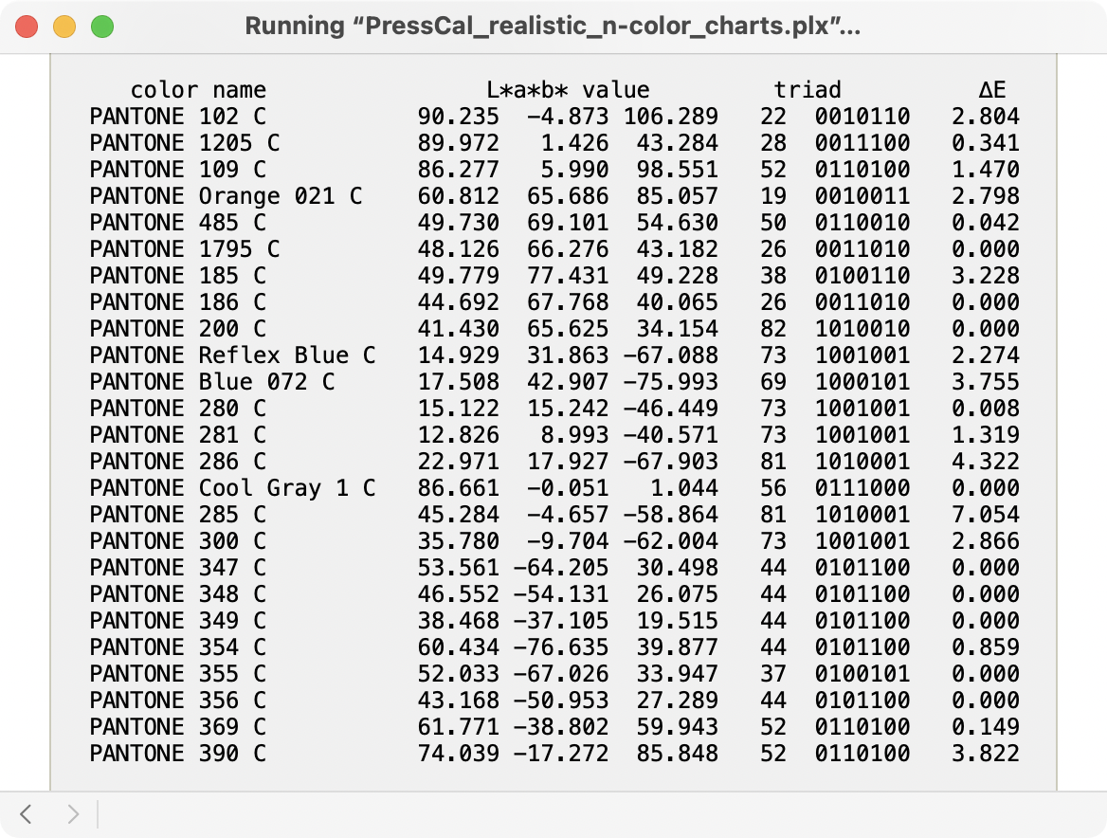
n-Color Charts Tool
+
Notes:
- The n-color charts tool performs two functions:
- Makes a calibration chart (original intent).
- Calculates spot color mixes (builds), which are appended to the chart.
- Next, I will explain the calculation of spot color mixes.
- There are three possible calculation modes, chosen by the ”mix” setting.

Slide 16
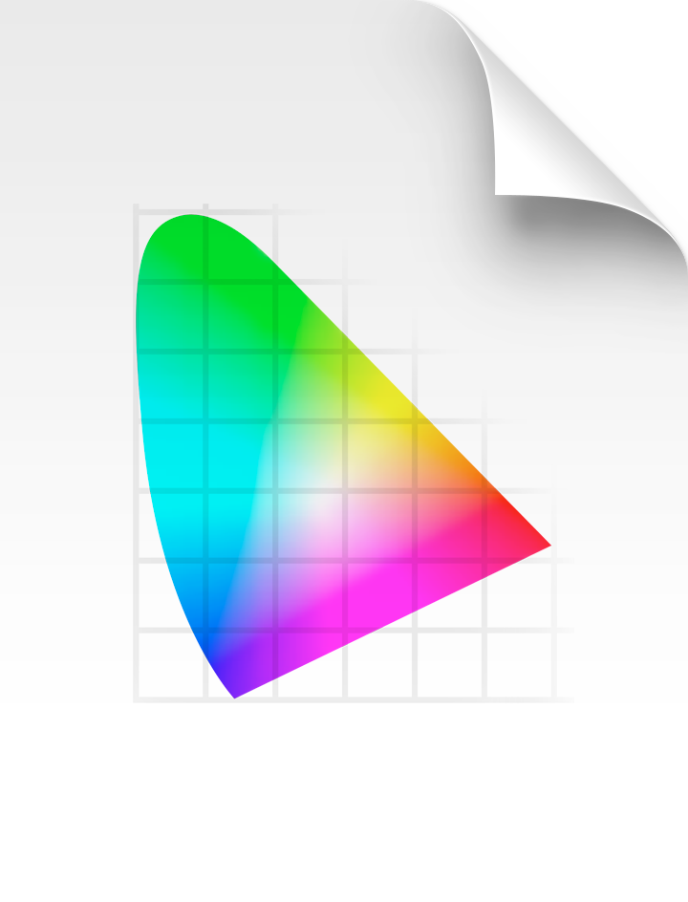
n-Color Charts Tool
Spot Color L*a*b* Values
ECG %-dot Values
B2A1 Tag
Mode = 0
Notes:
- When mode = 0, spot mixes come directly from the profile B2A1 tag.
- Mixes are determined by the profiling software and its settings.
- This is how RIP software typically handles spot color simulation.
- Color mixes may contain any or all process colors (not good).
- Color accuracy may be inadequate for critical work (not good).

Slide 17
n-Color Charts Tool
ECG %-dot Values
∆E = 0?
Spot Color L*a*b* Values
A2B1 Tag
Mode = 1 or 2
Notes:
- For modes 1 or 2, spot color mixes have 3 or fewer colors.
- They are computed differently, using the A2B1 tag.
- The %-dot values are adjusted until the ∆E = 0, or its minimum value (an iterative process, with %-dot limits).
- The algorithm provides control of the allowed color combinations, and their priority.

Slide 18
n-Color Charts Tool
ordered list for mode 1 (favoring CMY inks):
CMK CYK MYK CKO MKO YKO CKG MKG YKG CKV MKV YKV KOG KOV KGV CMY CMO CYO MYO CMG CYG MYG CMV CYV MYV COG MOG YOG COV MOV YOV CGV MGV YGV OGV
ordered list for mode 2 (favoring OGV inks):
KGV KOV KOG YKV MKV CKV YKG MKG CKG YKO MKO CKO MYK CYK CMK OGV YGV MGV CGV YOV MOV COV YOG MOG COG MYV CYV CMV MYG CYG CMG MYO CYO CMO CMY
ordered list for mode 2 (with filter simulating Esko Equinox):
MKV CKV YKG CKG YKO MKO MYK CYK CMK CMV CYG MYO CMY
3/C with black
3/C without black
CMK
CYK
MYK
CKO
MKO
YKO
CKG
MKG
YKG
CKV
MKV
YKV
KOG
KOV
KGV
CMY
CMO
CYO
MYO
CMG
CYG
MYG
CMV
CYV
MYV
COG
MOG
YOG
COV
MOV
YOV
CGV
MGV
YGV
OGV
Notes:
- For 7 process colors there are 35 possible combinations of 3 colors, 15 containing black and 20 without black.
- Here are the color combinations for a CMYKOGV process.
- We calculate all the color combinations in a certain order and choose the first to have ∆E = 0 or the one with minimum ∆E.
- Mixes using black ink are tested first. These combinations reduce metamerism and ink costs.
- ESC
- Review the tool settings.
- Many ways to specify spot colors.
- Filter setting allows control of ink combinations.
- Run the software (⌘ R)
- Review the output.
- Test chart and reference file.
- Spot color list.
- Adobe swatch file (.ase)

Slide 19
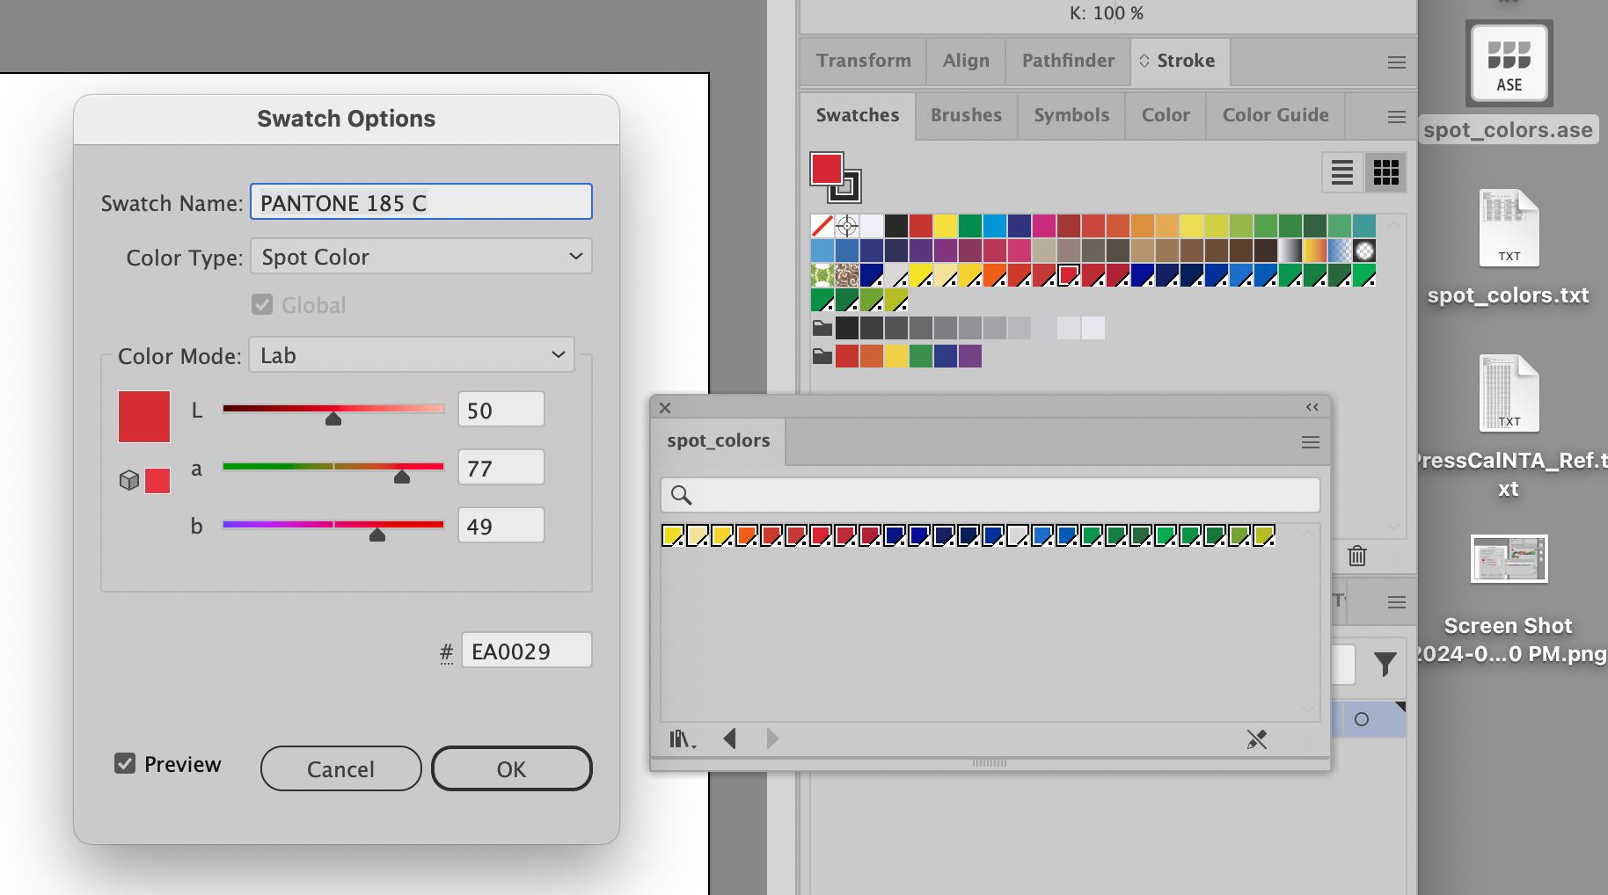
n-Color Charts Tool
Notes:
- Adobe swatch exchange file (.ase) can be opened in the Creative Suite apps.
- The spot colors are floating point L*a*b* values

Slide 20
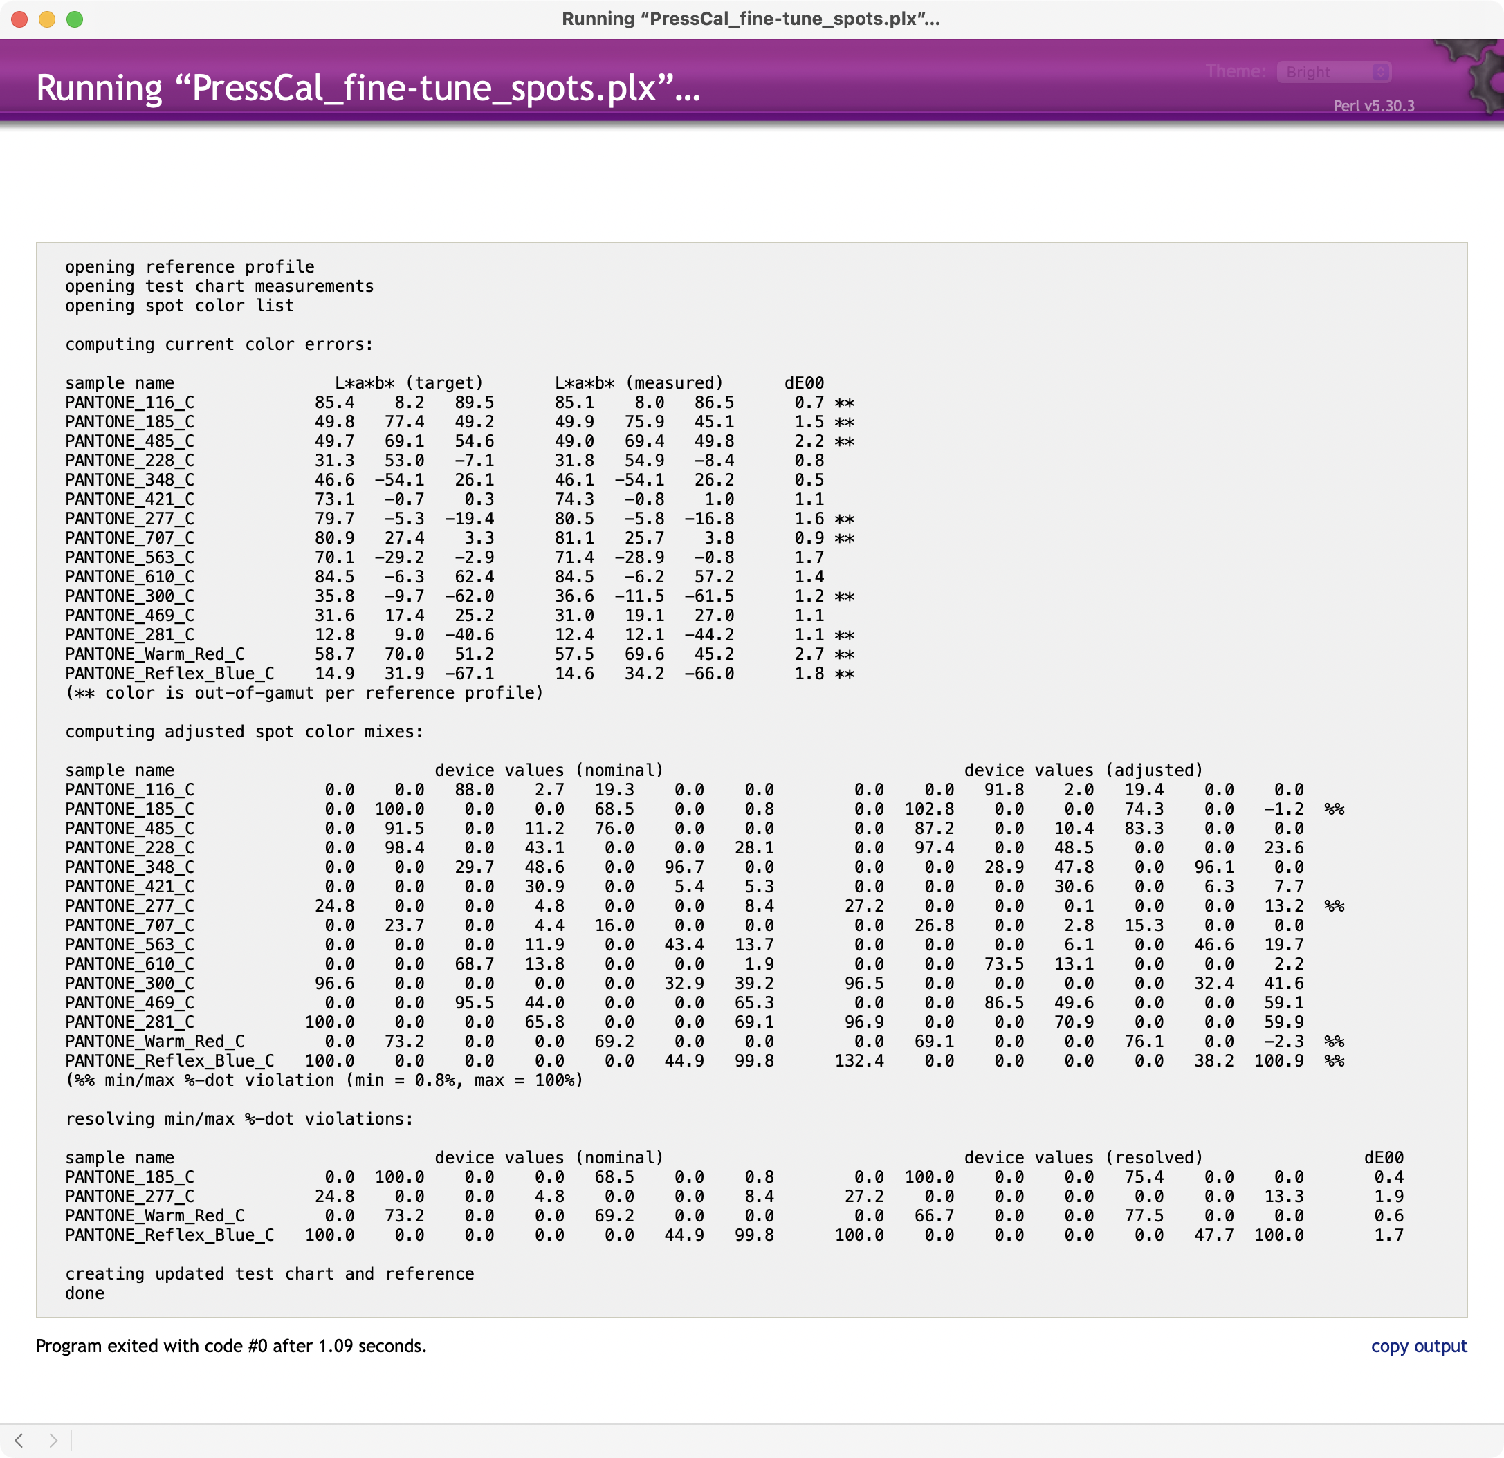
Fine-Tune Spot Colors Tool
Notes:
- The primary reason to print ECG is to replace spot colors with ECG mixes.
- For this to be accepted by customers, the ECG colors must be accurate.
- The initial calculated color mixes may not be accurate enough.
- This tool adjusts the color mixes using their measured values and the reference profile.
- The accuracy of the adjusted colors is quite good.
- Notice that some of the adjusted values are less than 0% or greater than 100% (imaginary values).
- They may also be less than the min %-dot or greater than the max %-dot.
- The software resolves these “violations” by re-computing the best color match.
- ESC
- Review the tool settings.
- Run the software (⌘ R)
- Review the output.
- Additional iterations are possible.
- This tool is optional.

Slide 21
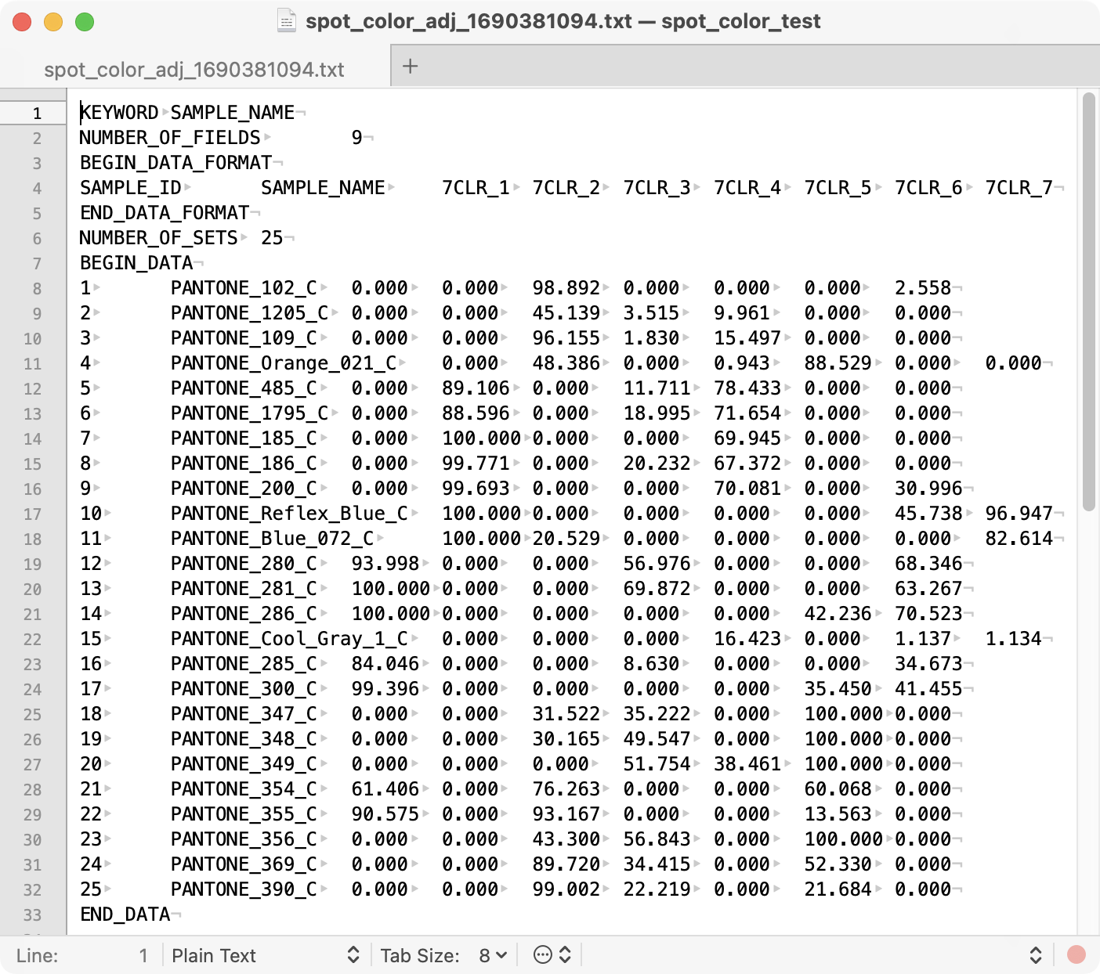
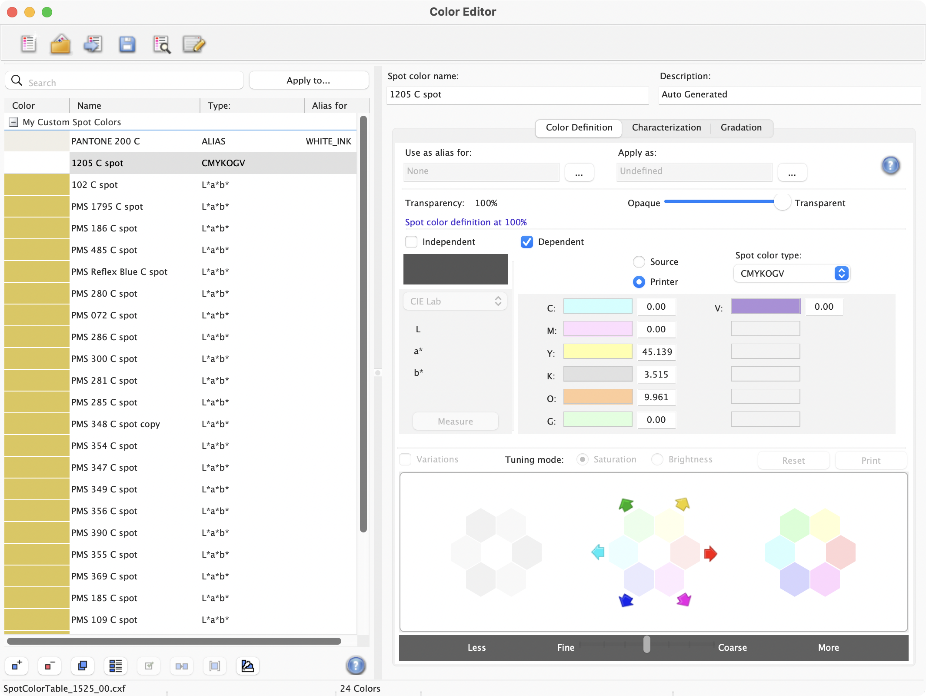
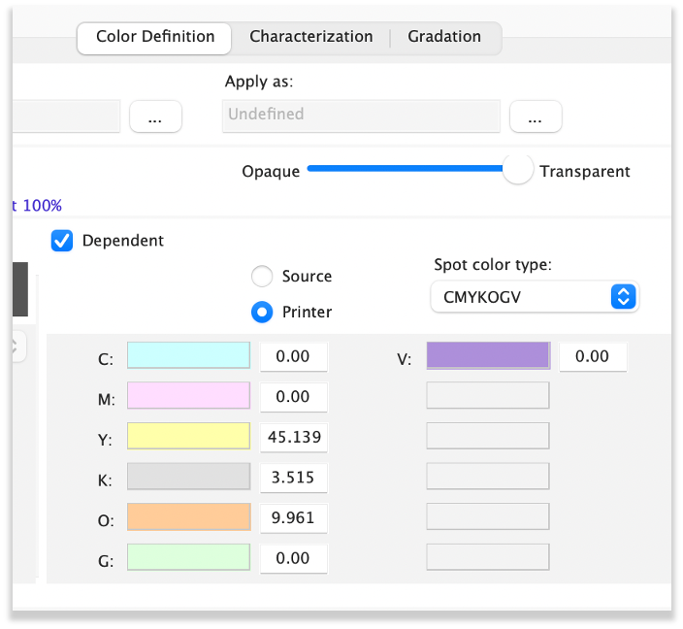
Spot Color Mapping Tool
How do we enter spot color mixes into the workflow?
Notes:
- The fine-tune spot colors tool outputs a list of spot colors and ECG mixes in CGATS format.
- These color values must now be inserted into the workflow.
- Here is how that’s done in Fiery XF.
- We thought this part would be easy. It was not easy!
- The Esko software does not support manual entry of spot color mixes (according to several Esko experts).
- Catherine and Kenny devised a clever workaround and were able to print our posters for the Fall Conference.
- Their workaround was messy – unsuitable for production.
- We ended the project with a bittersweet feeling. Although we accomplished some good things, we didn’t deliver a simple ECG solution.

Slide 22
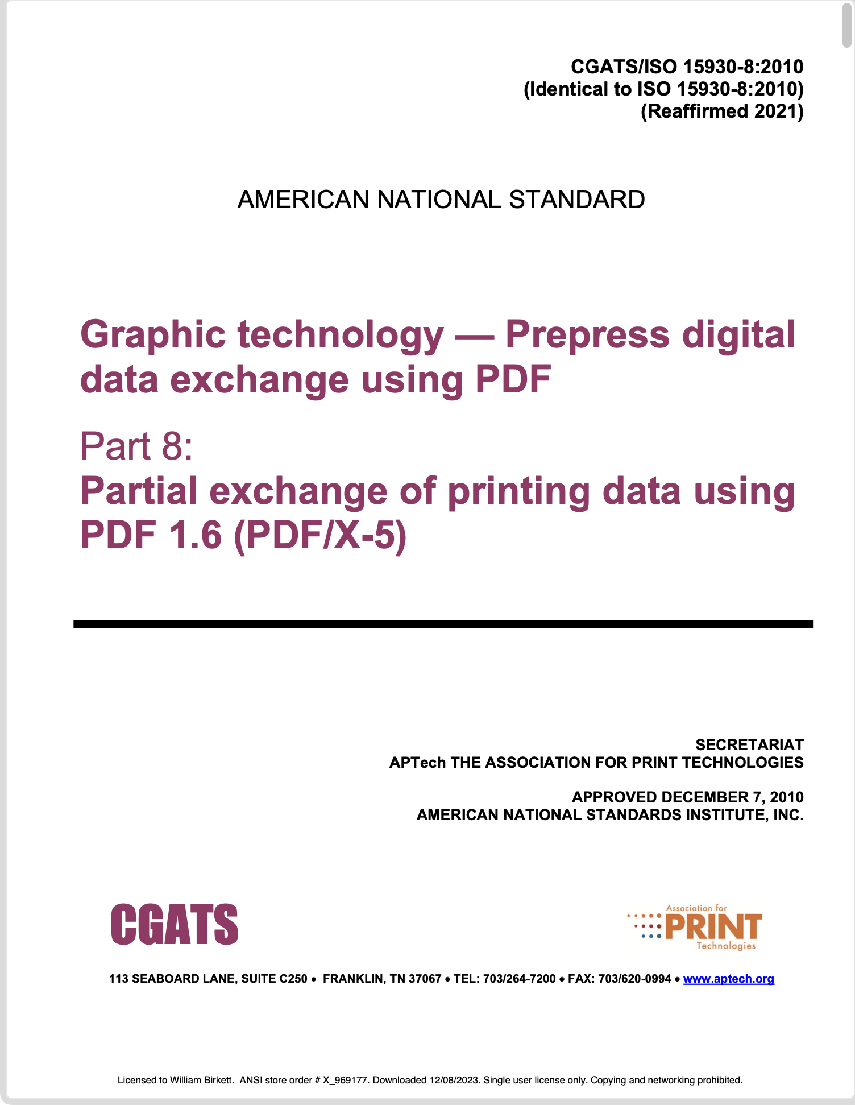
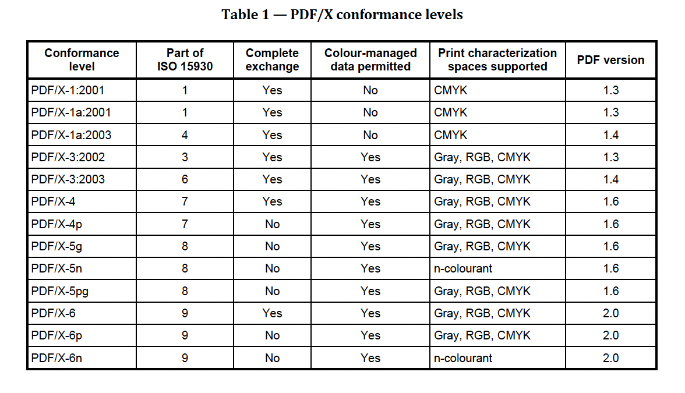
Spot Color Mapping Tool
Notes:
- Our struggle with the poster prepress led to development of the spot color mapping tool.
- The basic idea is to modify the PDF file before it is RIPed, replacing spot colors with ECG mixes.
- According to PDF workflow experts we consulted, there was no existing tool to do this.
- So, we created that tool!
- In 2010, ISO 15930-8 was released describing the PDF/X-5 standard.
- The PDF/X-5n level supports n-colorants making it suitable for ECG workflows.
- Our tool adds a DeviceN colorspace to the PDF. This colorspace is derived from the reference profile.
- Spot colors are replaced by DeviceN color mixes.
- Unused spot colorspaces are removed.
- ESC
- Review the source PDF in Acrobat.
- Show Ink Manager can only map to CMYK.
- Review the mapping tool settings.
- Run the software (⌘ R). It is fast.
- Review the modified PDF in Acrobat.
- PDFs can be used to make proofs and plates.
- PDF RIPed successfully at Clemson, comment from Kenny Tucker

Slide 23
Comments
Notes:
- Review the workflow diagram, locate each tool.
- Color management is done prior to RIPing. The PDF contains only DeviceCMYK, DeviceN, and spot colors.
- The RIP handles transparency, if any. Blending is done in Device colorspace.
- The PDF/X-5n workflow is DFE agnostic.
- Automated replacement of spot colors is quick and error-free.
- Spot color mixes may be accumulated as they are encountered.
- Manual adjustments to mixes are easily made in a text editor.
- ECG Tools work with any CMYK + N process, for example CMYKOV (Indigo or Domino). They even work for CMYK.
- Full CIE-015:2018 colorimetry is supported, including all standard illuminants and observers.
- Bump curves are applied to ICC profiles (printer or device links).
- Other tools enforce min/max %-dot constraints.
- PDFs are color-accurate in Acrobat Pro (good for soft proofing).
- Tools may be part of an automated process (CLI).

Slide 24
Overview of the ECG Tools
The following tools support a PDF/X-5n workflow, which allows DeviceN colorspaces.
PressCal_realistic_n-color_charts
PressCal_fine-tune_spots
PressCal_map_PDF_spot_colors_to_ECG
The following tools are used to manipulate measurement data sets.
PressCal_data_aggregator
PressCal_subset_from_n-color_data
PressCal_extract_M0_M1_M2_data
PressCal_limit_TAC_of_data
PressCal_data_set_from_profile
The following tools are used to modify and evaluate ICC profiles.
PressCal_merge_profiles
PressCal_edit_media_white_point
PressCal_apply_bump_curve_to_profile
PressCal_clear_profile_quality_flags
PressCal_evaluate_profile_quality
PressCal_evaluate_n-color_charts
Notes:
- We’ve already covered three tools used by the PDF/X-5n workflow.
- There are five tools for handling color measurements.
- There are six tools for merging and editing ICC profiles.

Slide 25
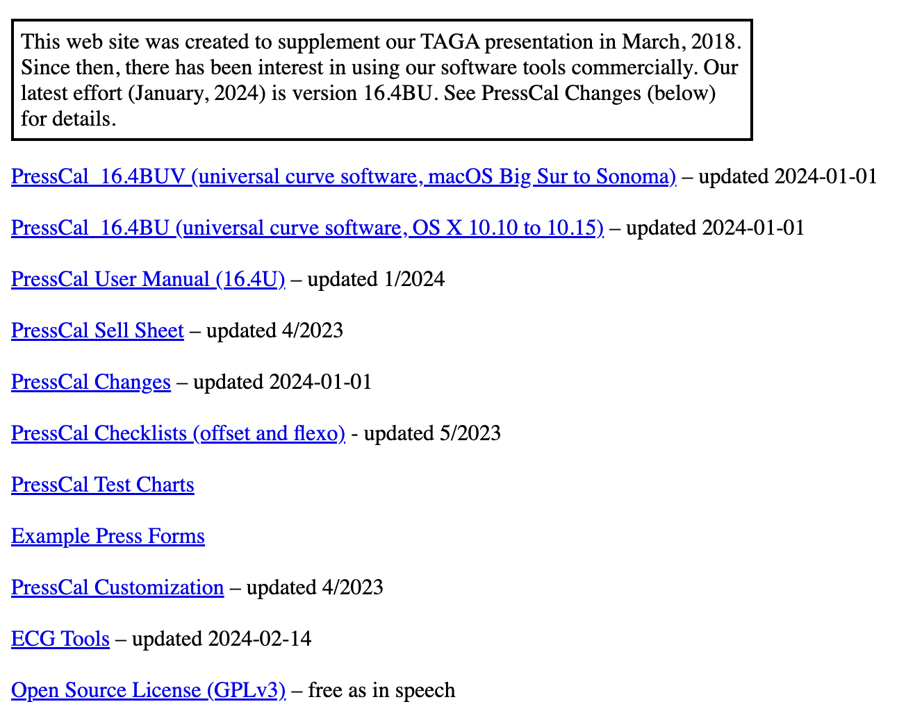
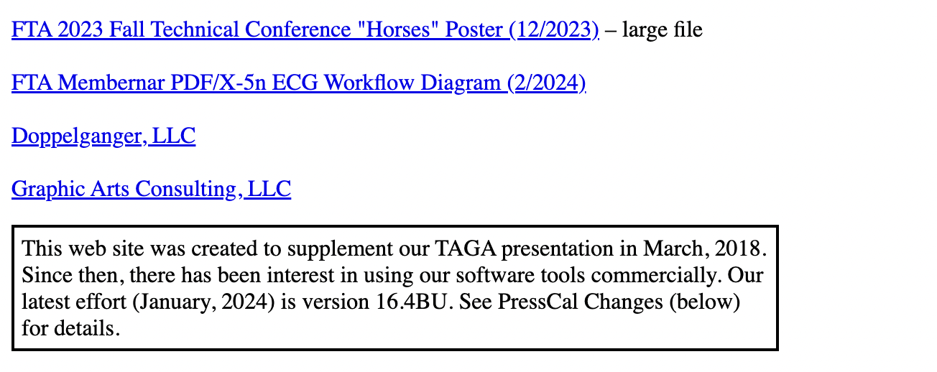
Installing and Using the Tools
Optimal Method Web Site
optimalmethod.org
Notes:
- Go to Optimal Method website
- Download and install PressCal (ECG Tools uses its software modules).
- Download and install ECG Tools.
- Read the instructions and run the tools with built-in data.
- Use your own data.
- The Fall Conference poster.
- The PDF/X-5n workflow diagram.

Slide 26
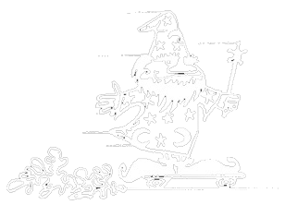
Steve’s Analysis
?
How does this use standards and compare to current practice?
Notes:
CHUCK/STEVE
Steve will discuss this inexpensive ECG workflow and tools from his familiarity of print standards
and his involvement of current brand practices.
QUESTIONS?

Slide 27

Contact Info
Optimal Method Web Site
optimalmethod.org
The Optimal Method web site contains software downloads and extensive background information.
Feel free to contact us via e-mail
steve@smileycolor.com
wbirkett@doplganger.com
chuck.spontelli@colortuneup.com
Notes:
Thank you for hearing our presentation.
Please feel free to contact us.

